Slide 1
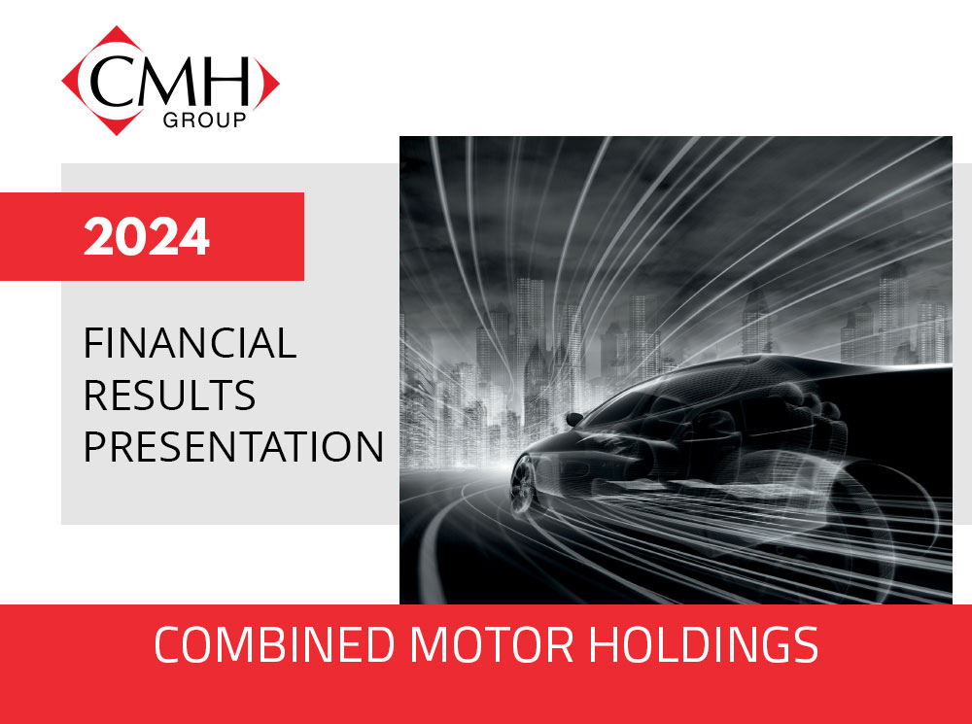

Slide 2

GROUP FINANCIAL HIGHLIGHTS
GROUP FINANCIAL HIGHLIGHTS FOR THE YEAR ENDED 29 FEBRUARY 2024
 |  | 2024 | 2023 | % Change
Total assets | (R’000) | 5,185,446 | 4,976,881 | 4.2
Cash resources | (R’000) | 815,105 | 761,876 | 7.0
Net asset value per share | (cents) | 1,828 | 1,690 | 8.2
Revenue | (R’000) | 12,839,564 | 12,434,375 | 3.3
Operating profit | (R’000) | 781,164 | 773,412 | 1.0
Operating profit to revenue | (%) | 6.1 | 6.2 | -1.6
Total profit and comprehensive income | (R’000) | 408,484 | 443,461 | -7.9
Return on shareholders’ funds | (%) | 31.0 | 37.3 | -16.9
Basic earnings per share | (cents) | 546.1 | 592.8 | -7.9
Headline earnings per share | (cents) | 541.8 | 617.1 | -12.2
Dividends paid per share | (cents) | 386.0 | 393.0 | -1.8
Dividend declared – payable June 2024 | (cents) | 220.0 | 240.0 | -8.3
1

Slide 3
MACRO
Challenging economic environment
- high interest rates
- prime rate - May 2023 – 11.75%
- highest in 14 years
- weak currency
- fuel price increases
- worsening power cuts
- poor governance
- political instability
- two wars in progress
On the positive side
- increase in tourism/business travel
2

Slide 4
GROUP OVERVIEW
Revenue increase driven by vehicle price increases, offset by marginally lower volumes. Also Land Rover change to ‘agency’ model.
Gross profit margin improved from 19.3% to 19.7%
- higher retail motor margins during first 6 months
- higher car hire mix
Selling and administration expenses contained at 8.9% increase, with employee costs up 3.2%
Finance costs were the differentiator
- on a similar inventory and car hire fleet asset base, finance costs
have increased as follows:
- R124 105 – 2022
- R192 764 – 2023
- R280 013 – 2024
The tax rate was down from 28.5% to 26.7%
3

Slide 5
GROUP OVERVIEW
high return on shareholders’ funds – 31%
sound balance sheet
strong cash flow generation – R815 million at year end
dividend proposed – 220 cents vs 240 cents
4

Slide 6
GROUP INCOME STATEMENT
GROUP INCOME STATEMENT
 |  | 2024 | 2023
 |  | R'000 | R'000
Revenue |  | 12,839,564 | 12,434,375
Cost of sales |  | -10,313,533 | -10,037,459
Gross profit |  | 2,526,031 | 2,396,916
Gross profit % |  | 19.7 | 19.3
Other income |  | 32,211 | 26,094
Goodwill impaired |  | 0 | -17,671
Selling and operating expenses |  | -1,777,078 | -1,631,927
Operating profit |  | 781,164 | 773,412
Operating profit % (excluding goodwill w/off) |  | 6.1 | 6.4
Finance income |  | 55,805 | 39,792
Finance costs |  | -280,013 | -192,764
Profit before taxation |  | 556,956 | 620,440
Tax expense |  | -148,472 | -176,979
Tax rate % |  | 26.7 | 28.5
Total profit and comprehensive income |  | 408,484 | 443,461
5

Slide 7
OPERATING MARGIN
6

Slide 8
CASH RESOUCES (R’million)
7

Slide 9
BLACK ECONOMIC EMPOWERMENT
  Group scorecard rating - level 4
  Car Hire scorecard rating - level 2
  CMH First Fleet Solutions - level 2
  Both Car Hire and First Fleet have 51% black ownership qualification
  Group scorecard adversely affected by motor manufacturers from which the majority of procurement is sourced
  Employment equity - 78% of staff are African, Coloured, Indian
8

Slide 10
CMH SHARES TRADED
 |  | 2024 | 2023 | 2022 | 2021 | 2020
Volume of shares traded ('000) |  | 7,307 | 9,830 | 12,162 | 11,227 | 9147
Value of shares traded (R'000) |  | 203,057 | 277,718 | 283,365 | 145,439 | 191,500
Average price per share traded (cents) |  | 2,779 | 2,825 | 2,330 | 1,295 | 2,093
Year-end market price (cents) |  | 2,650 | 2,868 | 2,800 | 1,550 | 1,840
Market capitalisation (R million) |  | 1,982 | 2,145 | 2,094 | 1,159 | 1,376
Year-end price : earnings ratio |  | 4.9 | 4.7 | 5.6 | 6.7 | 7.2
Year-end dividend yield (%) |  | 14.6 | 13.7 | 8.4 | 6.5 | 9.6
"Free-float" shares ('000) |  | 42,055 | 41,997 | 42,107 | 42,227 | 42,238
"Free-float" (%) |  | 56 | 56 | 56 | 57 | 57
9

Slide 11
SEGMENT PROFIT CONTRIBUTION
 |  | 2024 | 2023 | 2022 | 2021 | 2020
 |  | % | % | % | % | %
Car hire |  | 50 | 43 | 23 | -2 | 17
Motor retail / distribution |  | 34 | 44 | 66 | 86 | 57
Financial services |  | 15 | 12 | 11 | 12 | 17
Corporate services / other |  | 1 | 1 | 0 | 4 | 9
 |  | 100 | 100 | 100 | 100 | 100
10

Slide 12
MOTOR RETAIL / DISTRIBUTION
2024 | 2023 | 2022 | 2021 | 2020
R’000 | R’000 | R’000 | R’000 | R’000
187,565 | 273,789 | 336,069 | 202,437 | 150,049
Segment profit before taxation
INDUSTRY NEW VEHICLE SALES – CALENDAR YEAR
National market (passenger & light commercial) flat
Market share moves
  Chery +54% - off a low base
  Ford +16% - strong light commercial range
  Toyota + 9% - recovery after the floods
  Mazda -30% - pricing and supply problems
  Nissan -13% - discontinued light commercial models/pricing problems
  Haval -11% - lost market share to Chery
11

Slide 13
INDUSTRY NEW VEHICLE SALES
SALES (‘000 UNITS) - CALENDAR YEAR
PROJECTED
12

Slide 14
SEGMENT ANALYSIS – RETAIL MOTOR
GROUP NEW UNIT SALES BY MANUFACTURER (%)
13

Slide 15
MOTOR RETAIL / DISTRIBUTION
During financial year
  national sales down 1.2% - passenger down 5.7%, light commercial up 10.8%
  CMH sales down 1.9%
Vehicle sales
  continued gross overstocking at manufacturer level
  pressure on dealers to increase sales and inventory levels
  heavy discounting, low margins, depressed trade-in values
  hail damage to 10 000 vehicles – repaired and discounted in the market
  high interest rates exacerbate customer affordability crisis
  used vehicle values fluctuated widely
  focus on reduced inventory and faster rotation
Parts and service
  shortage of critical parts persists, affects customer satisfaction
  impact of new brands is increasing, but not yet at optimum level
14

Slide 16
MOTOR RETAIL / DISTRIBUTION
Mandarin Parts Distributors
  steady year, supply affected by harbour disruptions and inefficiencies
  profit up 20%
  28 independent franchisees
Proton vehicles
  imported from Malaysia
  sales below anticipated level
  favourably rated after test drives, few warranty claims
  inventory has been competitively repriced
Foton vehicles
  CMH appointed importer and distributor of Foton range of light commercial vehicles and taxis
  multifranchised with Mazda, Honda and Nissan dealerships to complement their product offering where light commercial models have been discontinued
  dealer network established – 43 outlets including 5 medium-sized motor retail groups (11 CMH)
  number 1 light commercial brand in China, also available as EVs
  the three traditional light commercial brands in our market have been significantly repriced, leaving a ‘gap’ for a competitively priced offering with full specifications
  all models are priced most competitively in their class
15

Slide 17

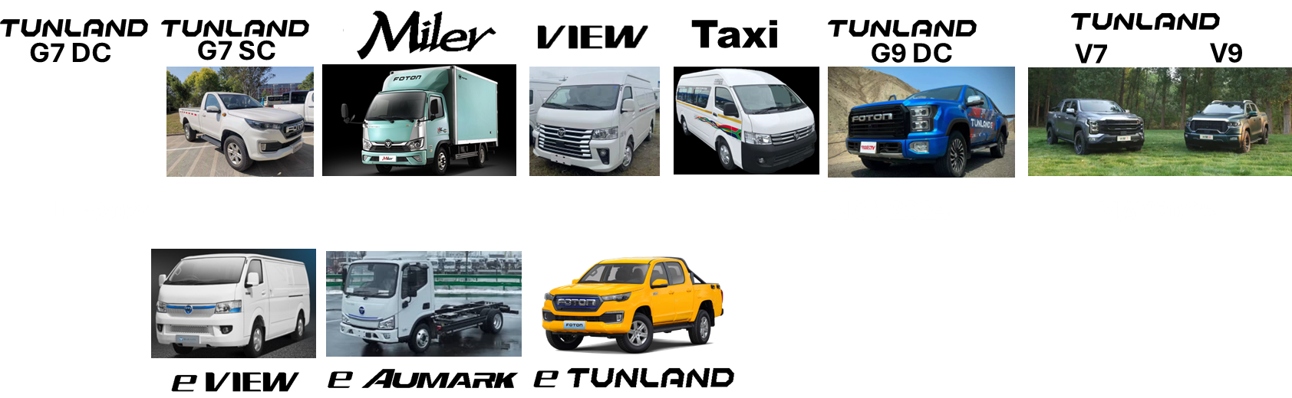
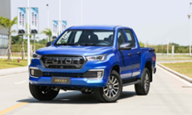

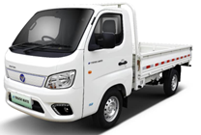

Timeline and Range
JUN2024
NOV2024
MAY2025
Jun2025
NOV2024
MAY2025
16

Slide 18
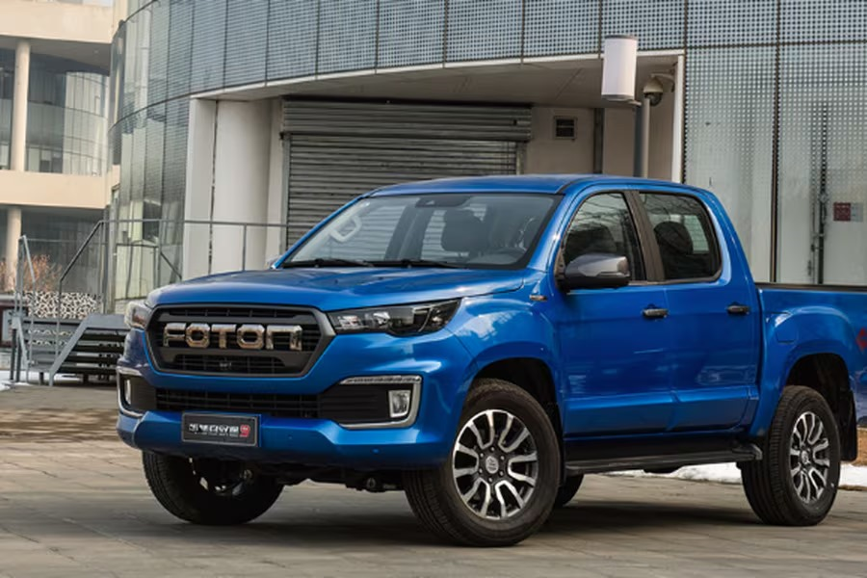
17

Slide 19
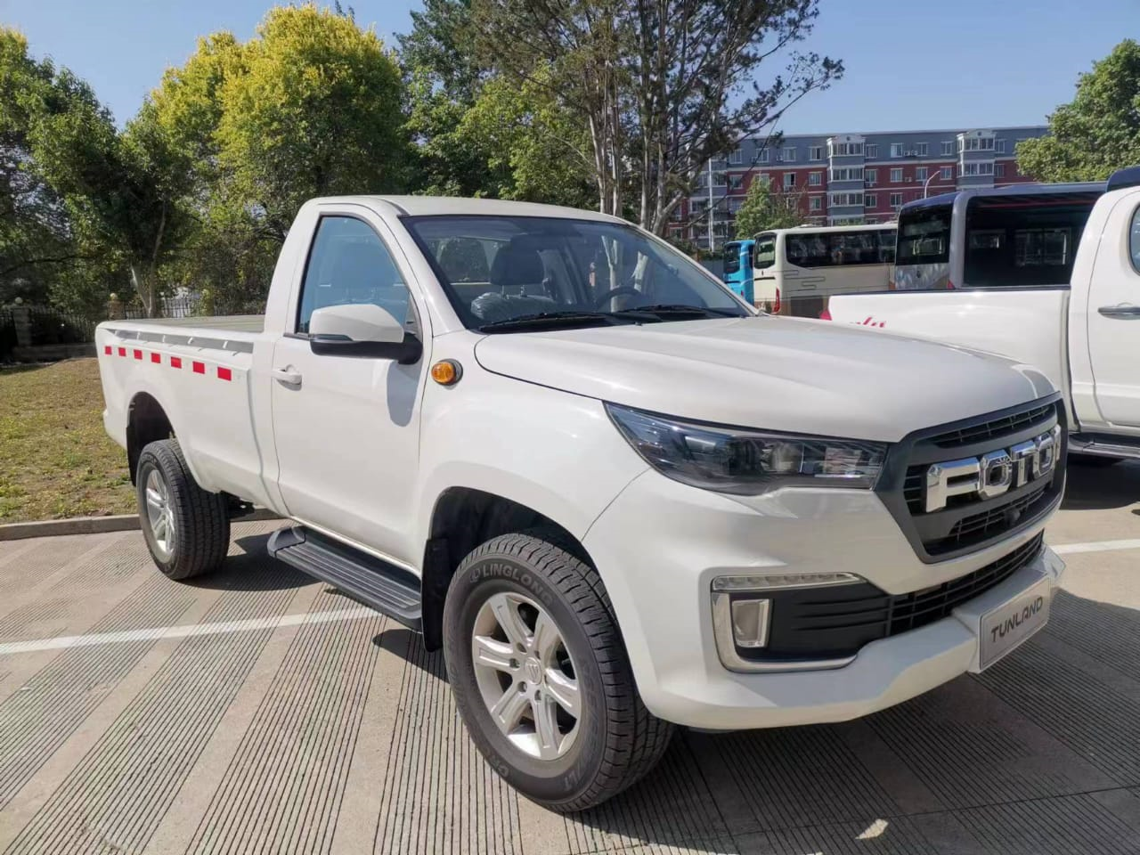
18

Slide 20
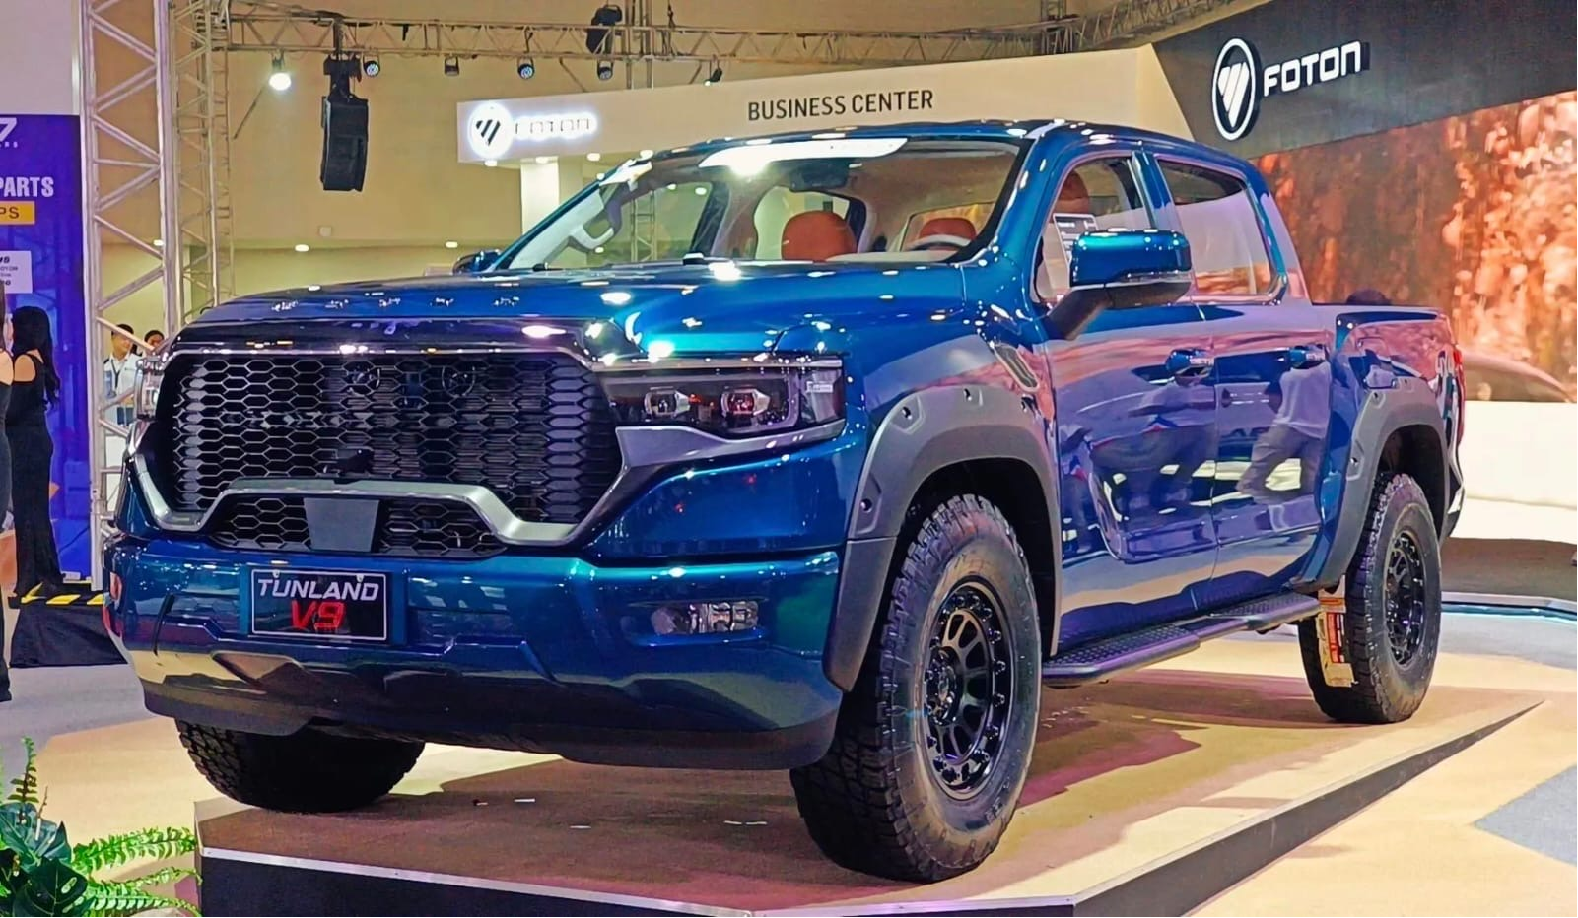
19

Slide 21
CAR HIRE
2024 | 2023 | 2022 | 2021 | 2020
R’000 | R’000 | R’000 | R’000 | R’000
280,385 | 268,587 | 115,945 | -5,103 | 45,178
Segment profit before taxation
boosted by tourism and corporate travel
alliance with FlySafair mutually beneficial
insurance replacement market steady
daily hire rate down 3%
- increased competition
- higher mix of lower value fleet vehicles
fleet holding costs volatile
- manufacturer oversupply created buying opportunities
- pricing and interest rates remain a negative factor
forward order book positive
20

Slide 22
FINANCIAL SEVICES
2024 | 2023 | 2022 | 2021 | 2020
R’000 | R’000 | R’000 | R’000 | R’000
83,244 | 73,046 | 56,159 | 28,046 | 44,637
Segment profit before taxation
Relates to finance JVs and insurance underwriting
Higher level of financeable business generated
Improved interest rate margin
Insurance cells recorded flat revenue and lower claims, profit up 25%
21

Slide 23
PROSPECTS
The year ahead will be characterized by uncertainty
  elections, with various possible outcomes
  expected interest rate cuts have been pushed back
  load-shedding forecasts unreliable
  modest economic growth will not reverse the unemployment dilemma
  NAAMSA pins its expectations for 2024 on a reversal of the interest rate trend and an easing in inflation
  car hire leases at airports still not addressed
The CMH Group has strong credentials and is well positioned to exploit whatever opportunities arise
  diverse range of motor retail products - mix favours the lower-priced volume models
  expected success of the Foton project
  car hire business mix is well balanced and stable
  both tourism and corporate markets expect growth, but competition will intensify
  strong, experienced management team
  sound, conservative and liquid balance sheet
22

Slide 24

Notes:
,

